Slide 1


SIMATS ENGINEERING
SAVEETHA SCHOOL OF ENGINEERING
DSA0305 – Natural Language Processing
Evolution of Natural Language Processing: From Rule-Based Systems to Modern NLP
Supervisor:
Dr. Anbazhagan K
Professor
Done by:
Sahasra Medarametla (192425317)

Slide 2
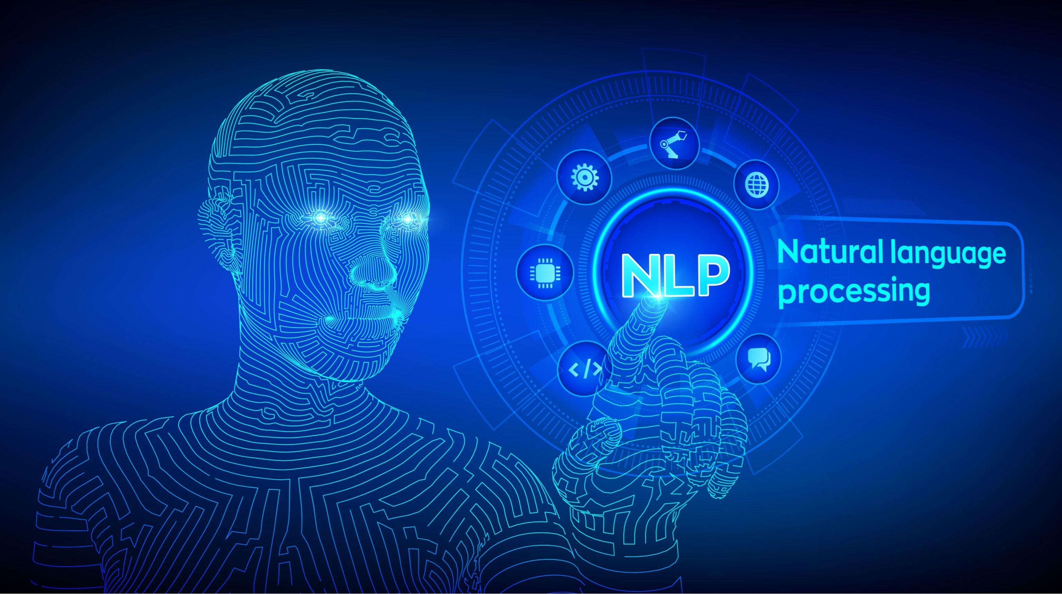
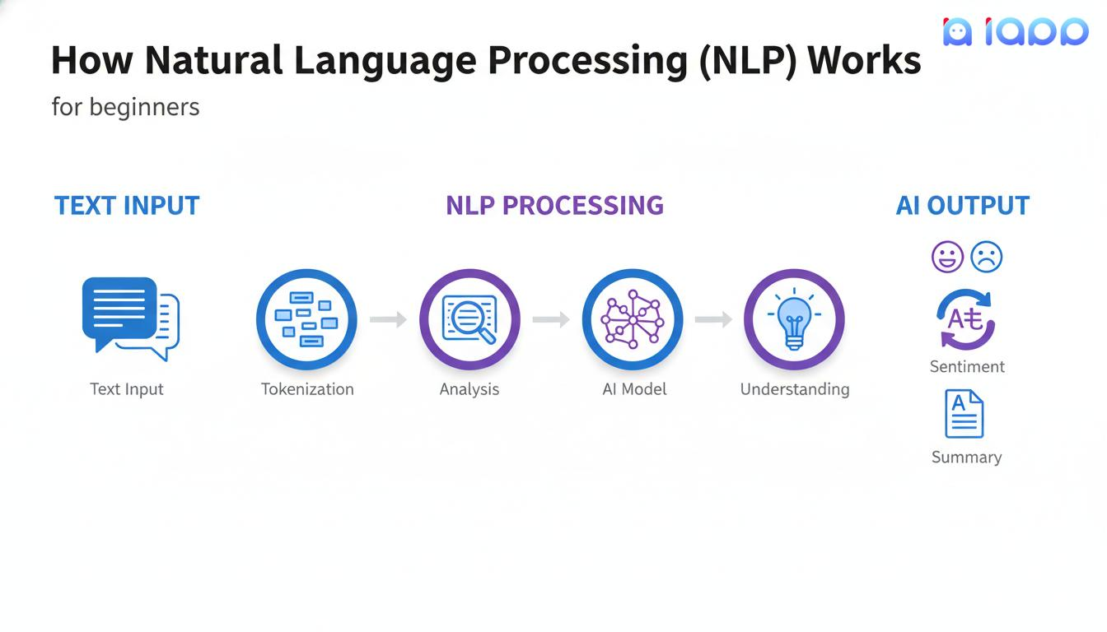
What is Natural Language Processing (NLP)?
NLP is a branch of Artificial Intelligence.
It enables computers to understand, interpret, and generate human language.
Combines Linguistics, Machine Learning, and Computer Science.
Used in text, speech, and language-based applications.
Applications
Chatbots
Voice Assistants
Machine Translation
Sentiment Analysis
Text Summarization

Slide 3
Evolution of NLP
Time Period | Stage | Key Characteristics
1950–1980 | Rule-Based NLP | Relied on manually written grammar rules and dictionaries. No learning from data.
1980–2000 | Statistical NLP | Used probability and statistical models trained on text corpora to process language.
2000–2015 | Machine Learning-Based NLP | Algorithms learned language patterns from datasets, improving accuracy and reducing manual rule creation.
2015–Present | Deep Learning & Modern NLP | Neural networks and Transformer models understand context, semantics, and generate human-like text.

Slide 4
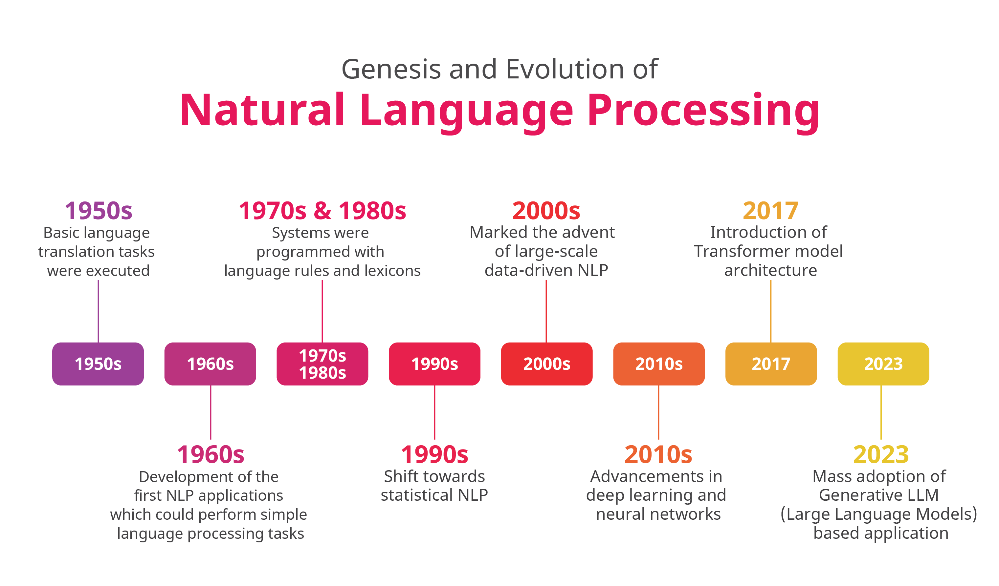
Evolution of NLP

Slide 5
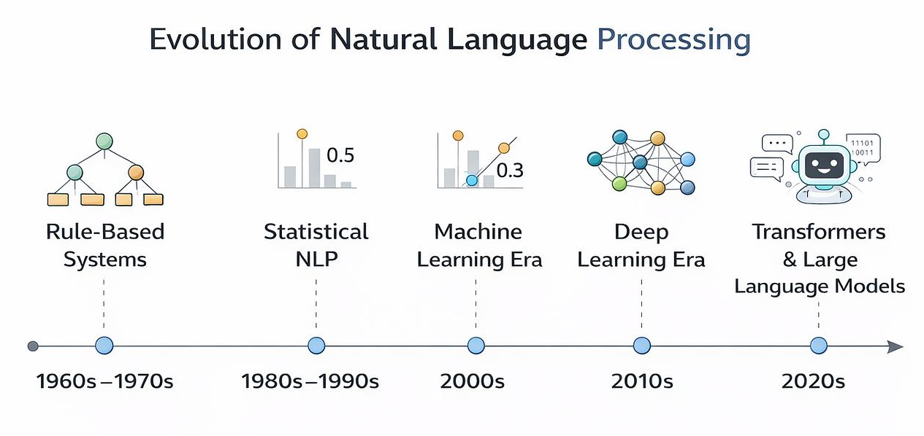
Evolution of NLP
Key Milestones:
1950s: Beginning of NLP research (Turing Test proposed).
1966: ELIZA, one of the first chatbot programs.
1980s: Rise of Statistical NLP techniques.
2013: Word2Vec introduced word embeddings.
2017: Transformer architecture introduced ("Attention Is All You Need").
2018–Present: Large Language Models (LLMs) such as BERT, GPT, and Gemini revolutionized NLP.

Slide 6
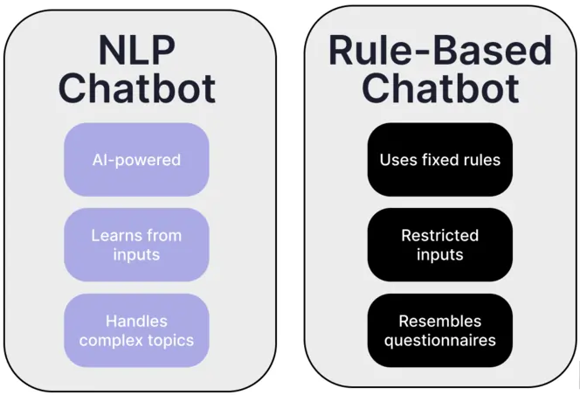
Rule-Based NLP
Features:
Uses predefined grammar rules.
Relies on dictionaries and linguistic knowledge.
Requires manual programming.
Suitable for simple language processing tasks.
Advantages:
Easy to understand
Accurate for limited domains
Limitations:
Difficult to maintain
Cannot understand context
Poor scalability
Examples:
Grammar Checker
Early Machine Translation

Slide 7
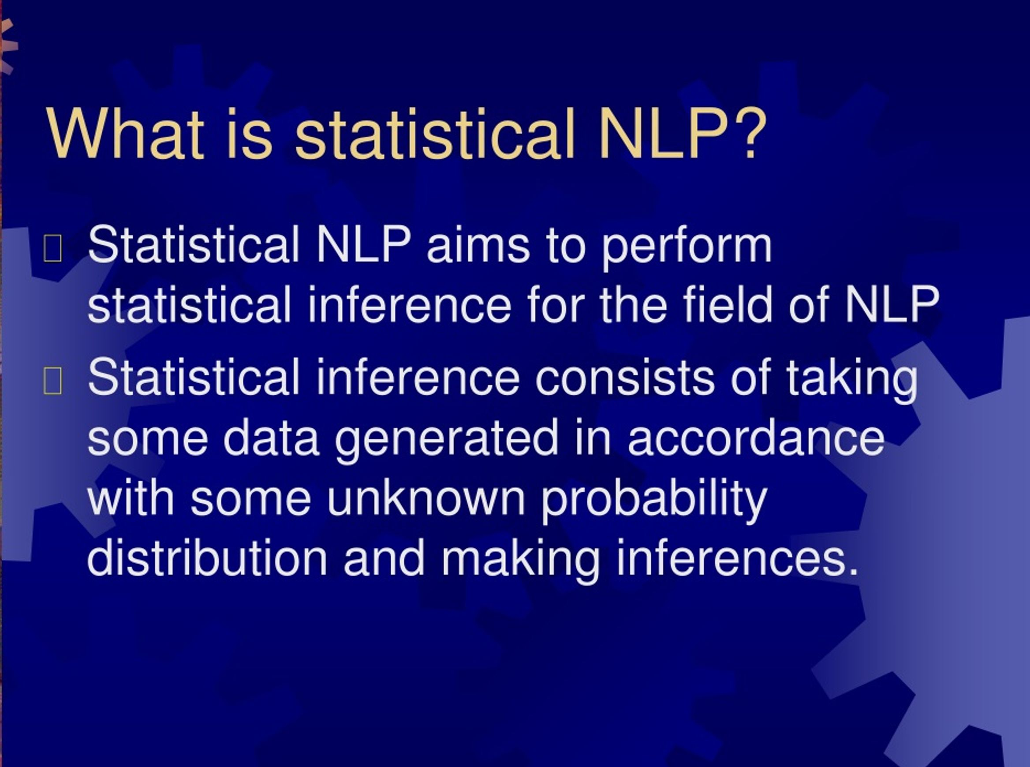
Statistical NLP
Features
Uses probability and statistics.
Learns from large text datasets.
Predicts the most likely words or sentences.
Common Techniques
Hidden Markov Model (HMM)
Naïve Bayes
N-gram Models
Advantages
Better than rule-based systems
Handles ambiguity
Limitations
Needs large datasets
Limited contextual understanding

Slide 8
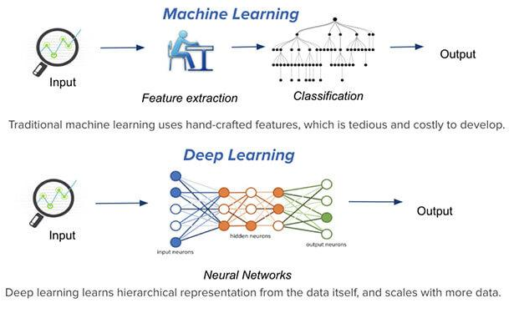
Machine Learning & Deep Learning NLP
Machine Learning
Learns patterns from data.
Improves accuracy automatically.
Deep Learning
Uses Artificial Neural Networks.
Understands complex language structures.
Algorithms
CNN
RNN
LSTM
GRU
Benefits
Better prediction
Higher accuracy
Reduced manual effort

Slide 9
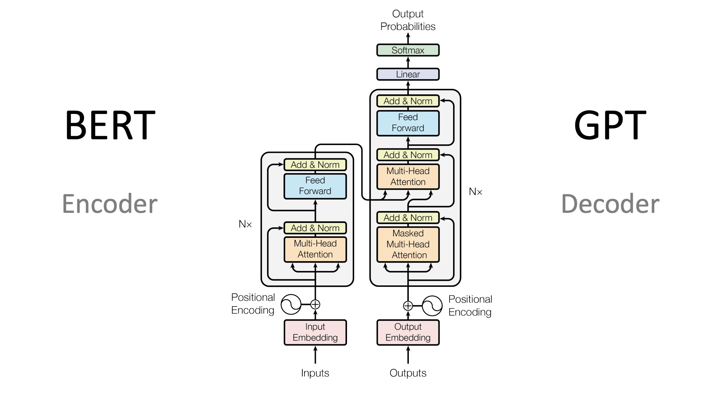
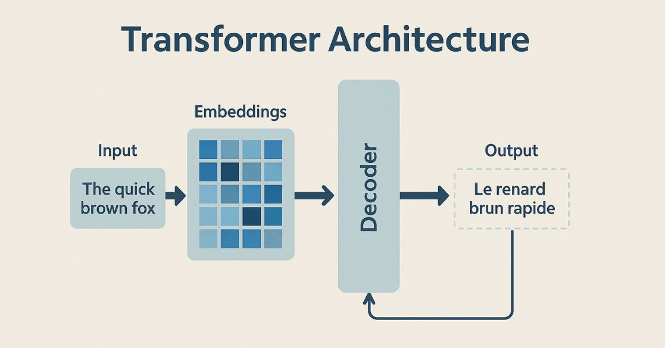
Transformer Models & Modern NLP
Introduction
Transformers revolutionized NLP by understanding context more effectively.
Popular Models
BERT
GPT
T5
RoBERTa
LLaMA
Gemini
Features
Attention Mechanism
Parallel Processing
Better Context Understanding
Faster Training

Slide 10
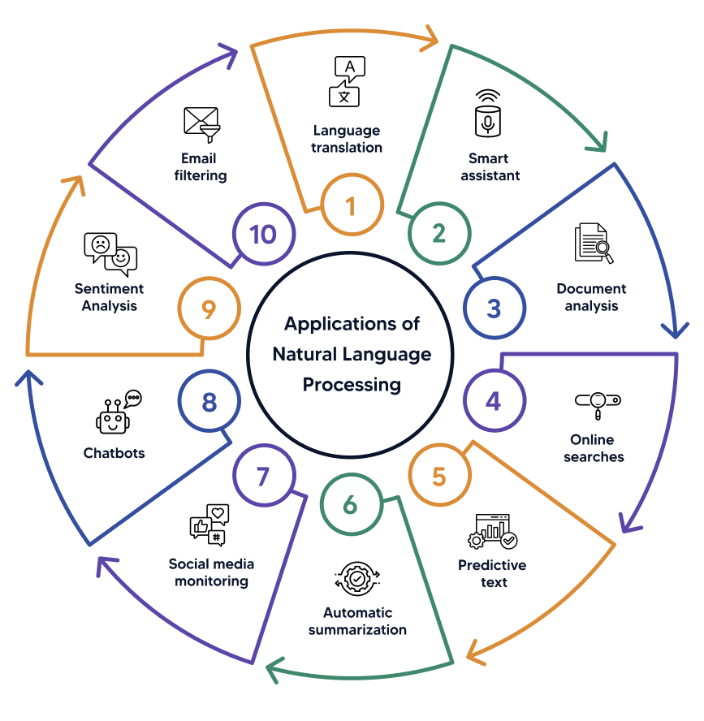
Applications of Modern NLP
Real-World Applications
ChatGPT
Google Translate
Siri
Alexa
Grammarly
Email Spam Detection
Sentiment Analysis
Healthcare
Finance
Education

Slide 11
Comparison
Feature | Rule-Based NLP | Modern NLP
Method | Manual Rules | Deep Learning
Learning | No | Yes
Context Understanding | Poor | Excellent
Accuracy | Moderate | High
Scalability | Low | High
Maintenance | Difficult | Easier
Examples | Grammar Checkers | ChatGPT, Gemini

Slide 12

CONCLUSION
Key Takeaways
NLP has evolved from rule-based systems to intelligent AI models.
Statistical methods improved language understanding.
Machine Learning introduced data-driven learning.
Transformers and LLMs have revolutionized NLP.
Modern NLP powers today's smart applications and will continue to shape the future of AI.

Slide 13


